Slide 2
ELEMENTARY & MS/HS LIBRARIES
NEW BOOKS – FICTION, NONFICTION, REFERENCE
Over 630 Books Purchased So Far
E-BOOKS (Digital)
ATTRACTIVE DISPLAYS AND SHELVING
PROCESSING SUPPLIES TO HELP BOOKS LAST LONGER AND DESIGNATE NATIVE AMERICAN TITLES
VIRTUAL AUTHOR VISITS

Slide 4
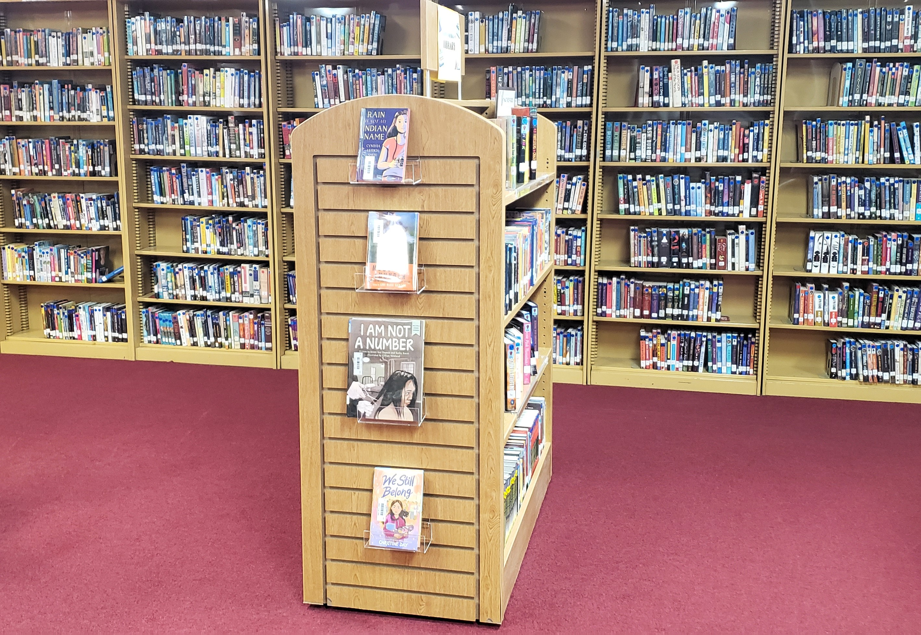

Slide 5
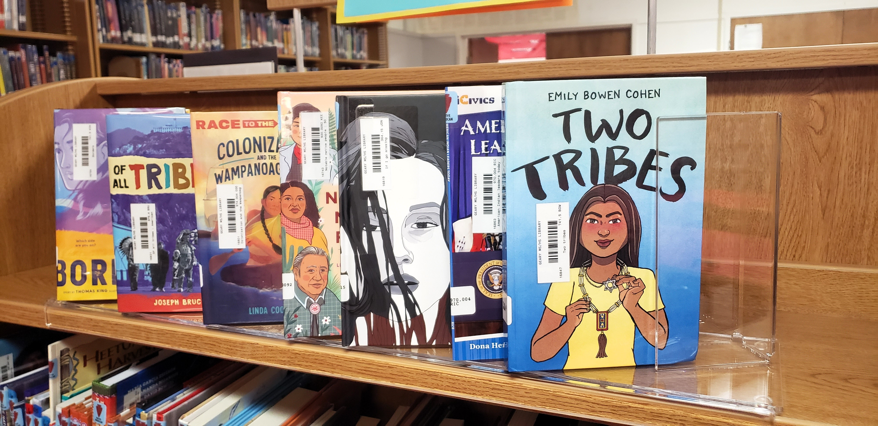

Slide 6
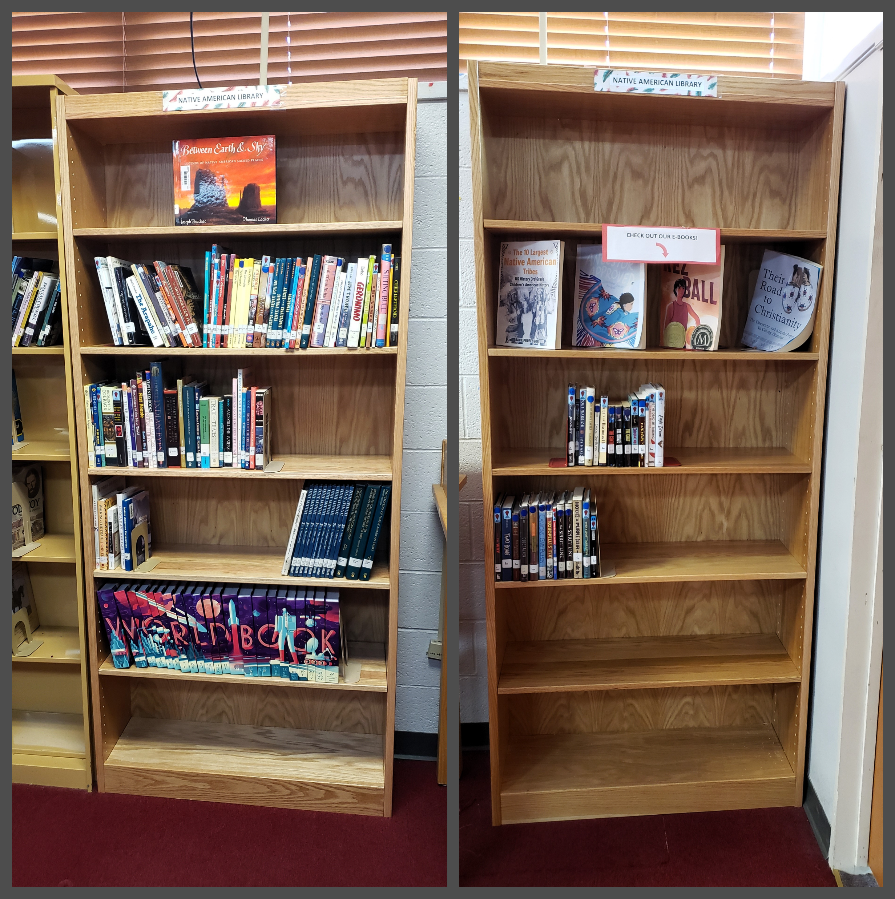

Slide 7
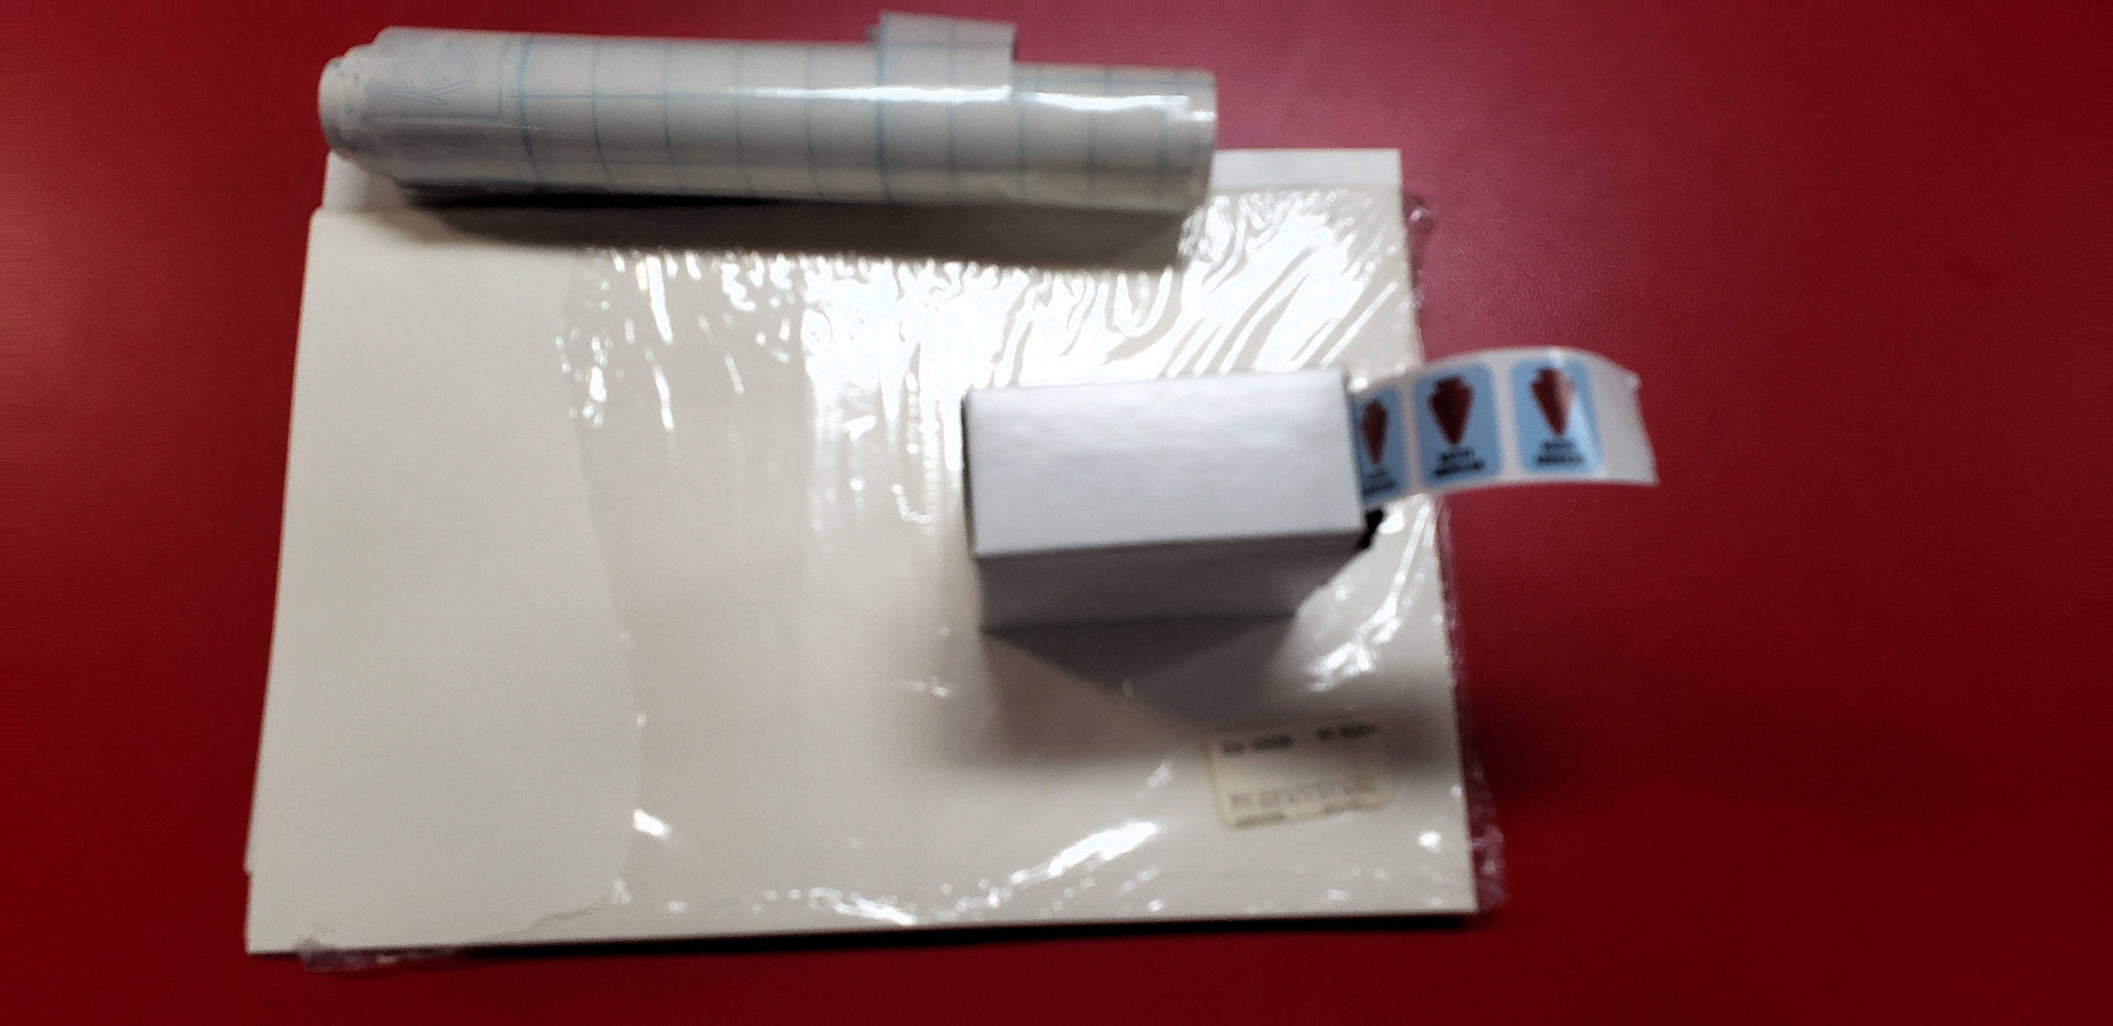

Slide 8
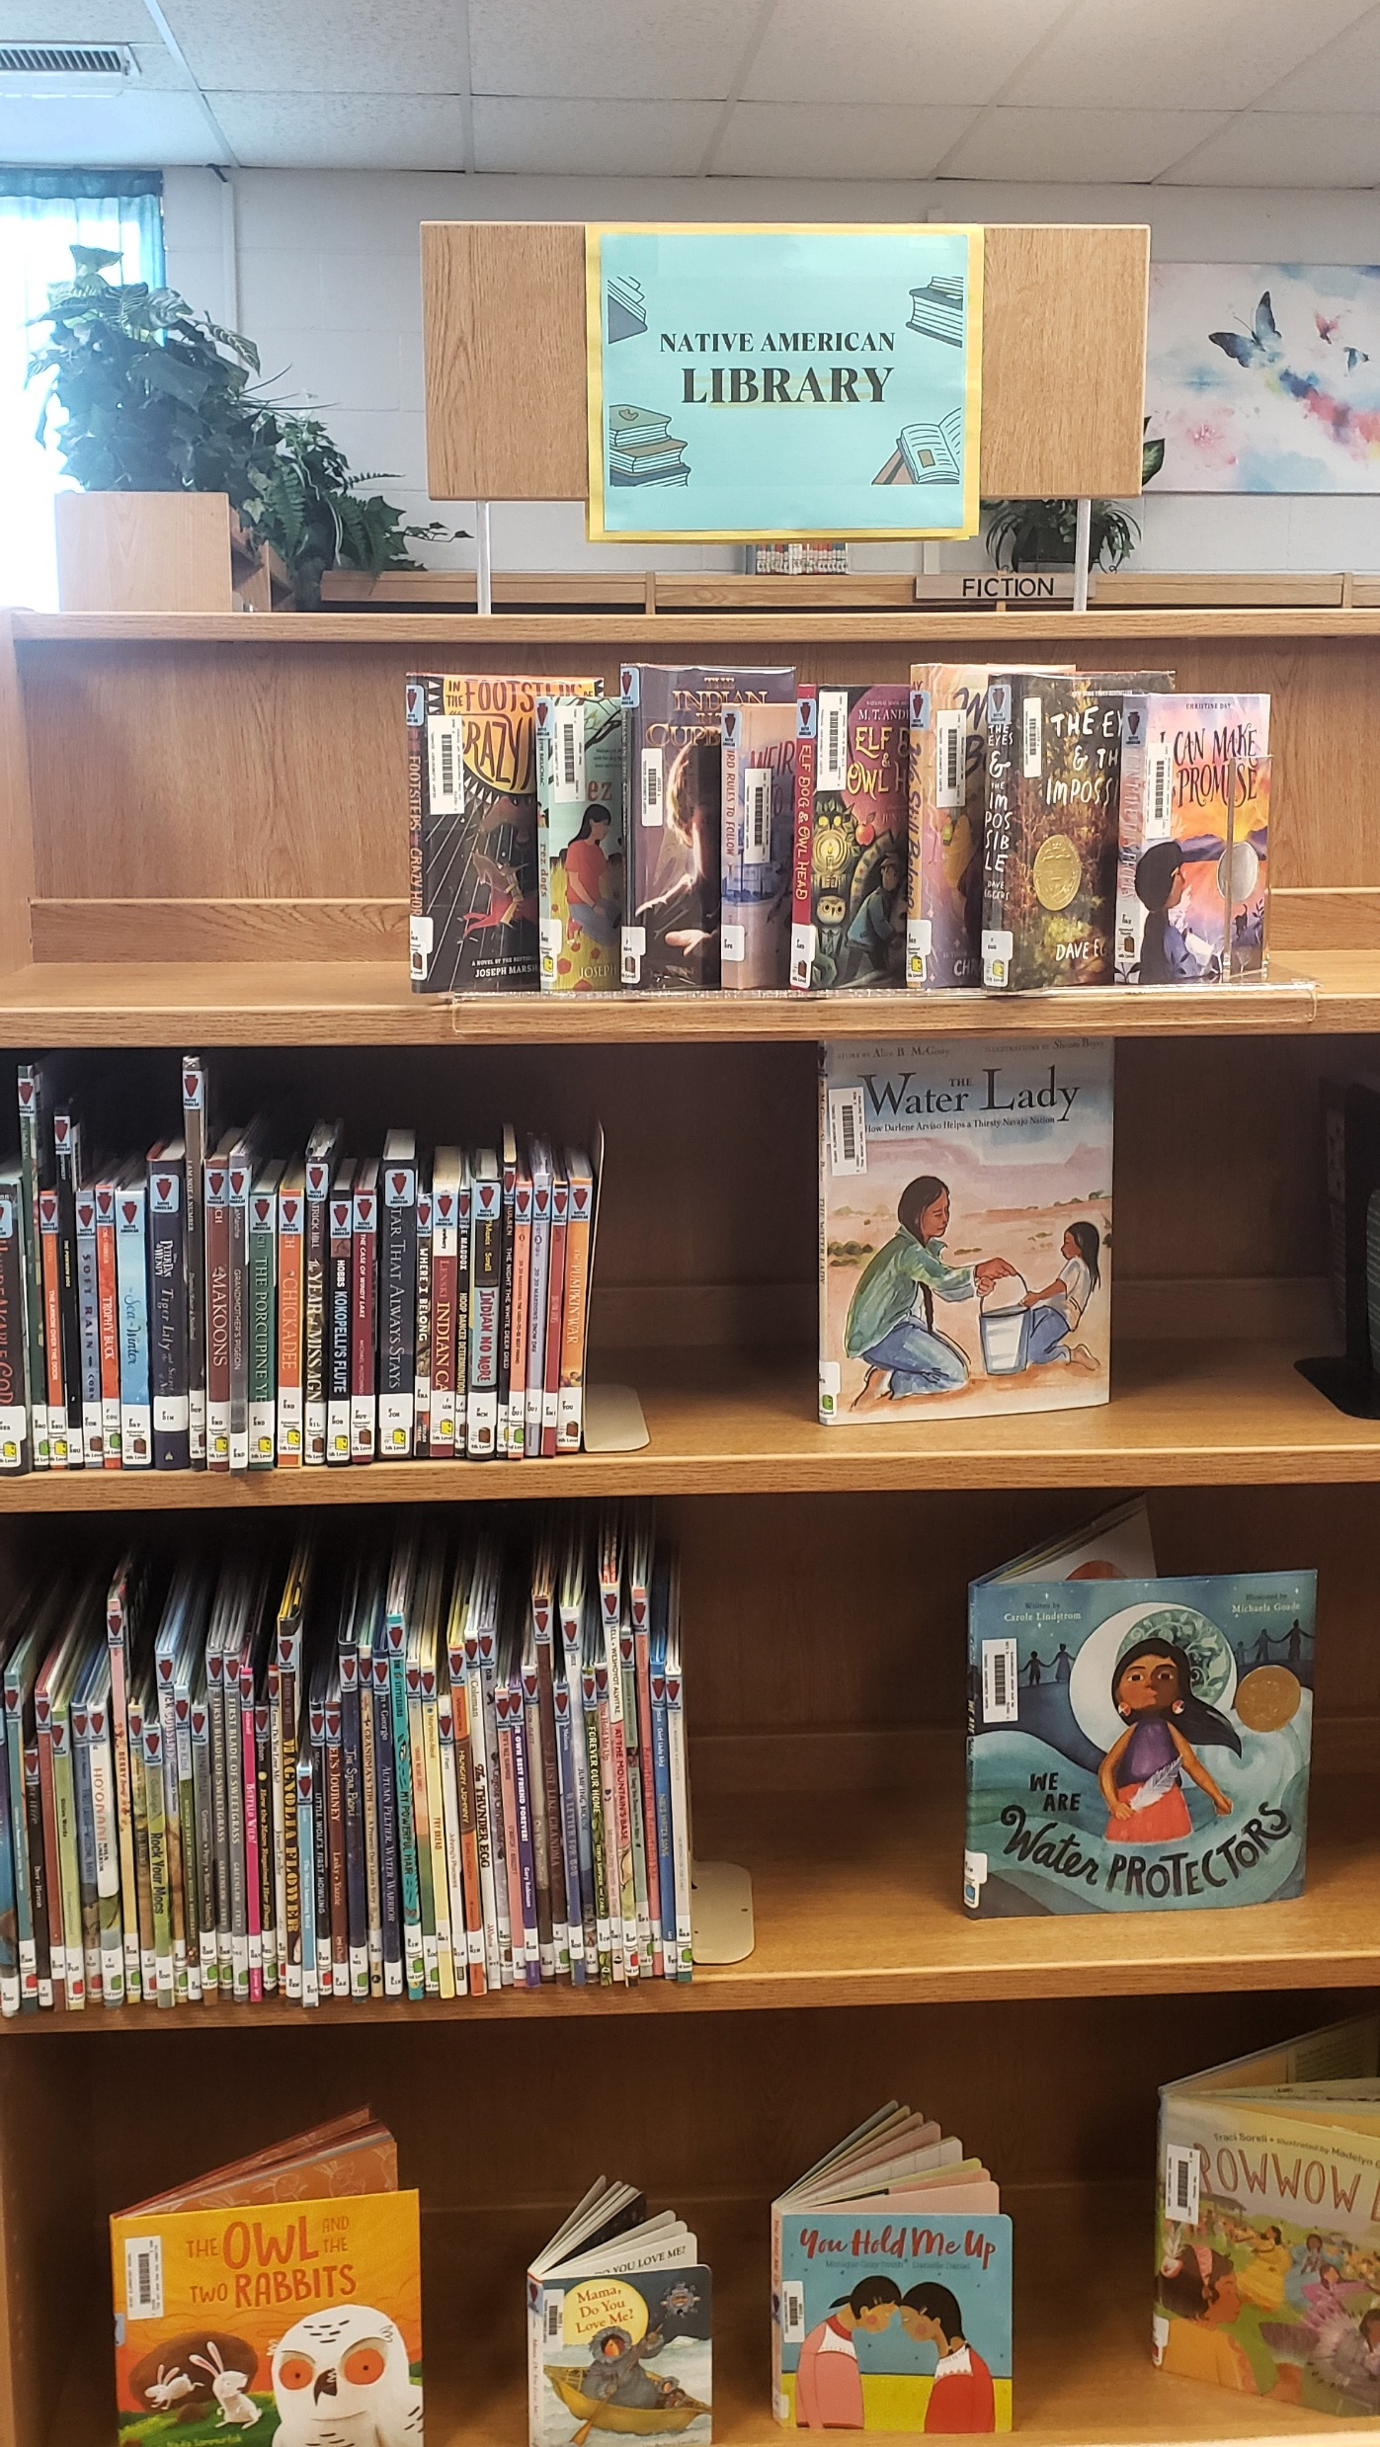

Slide 9
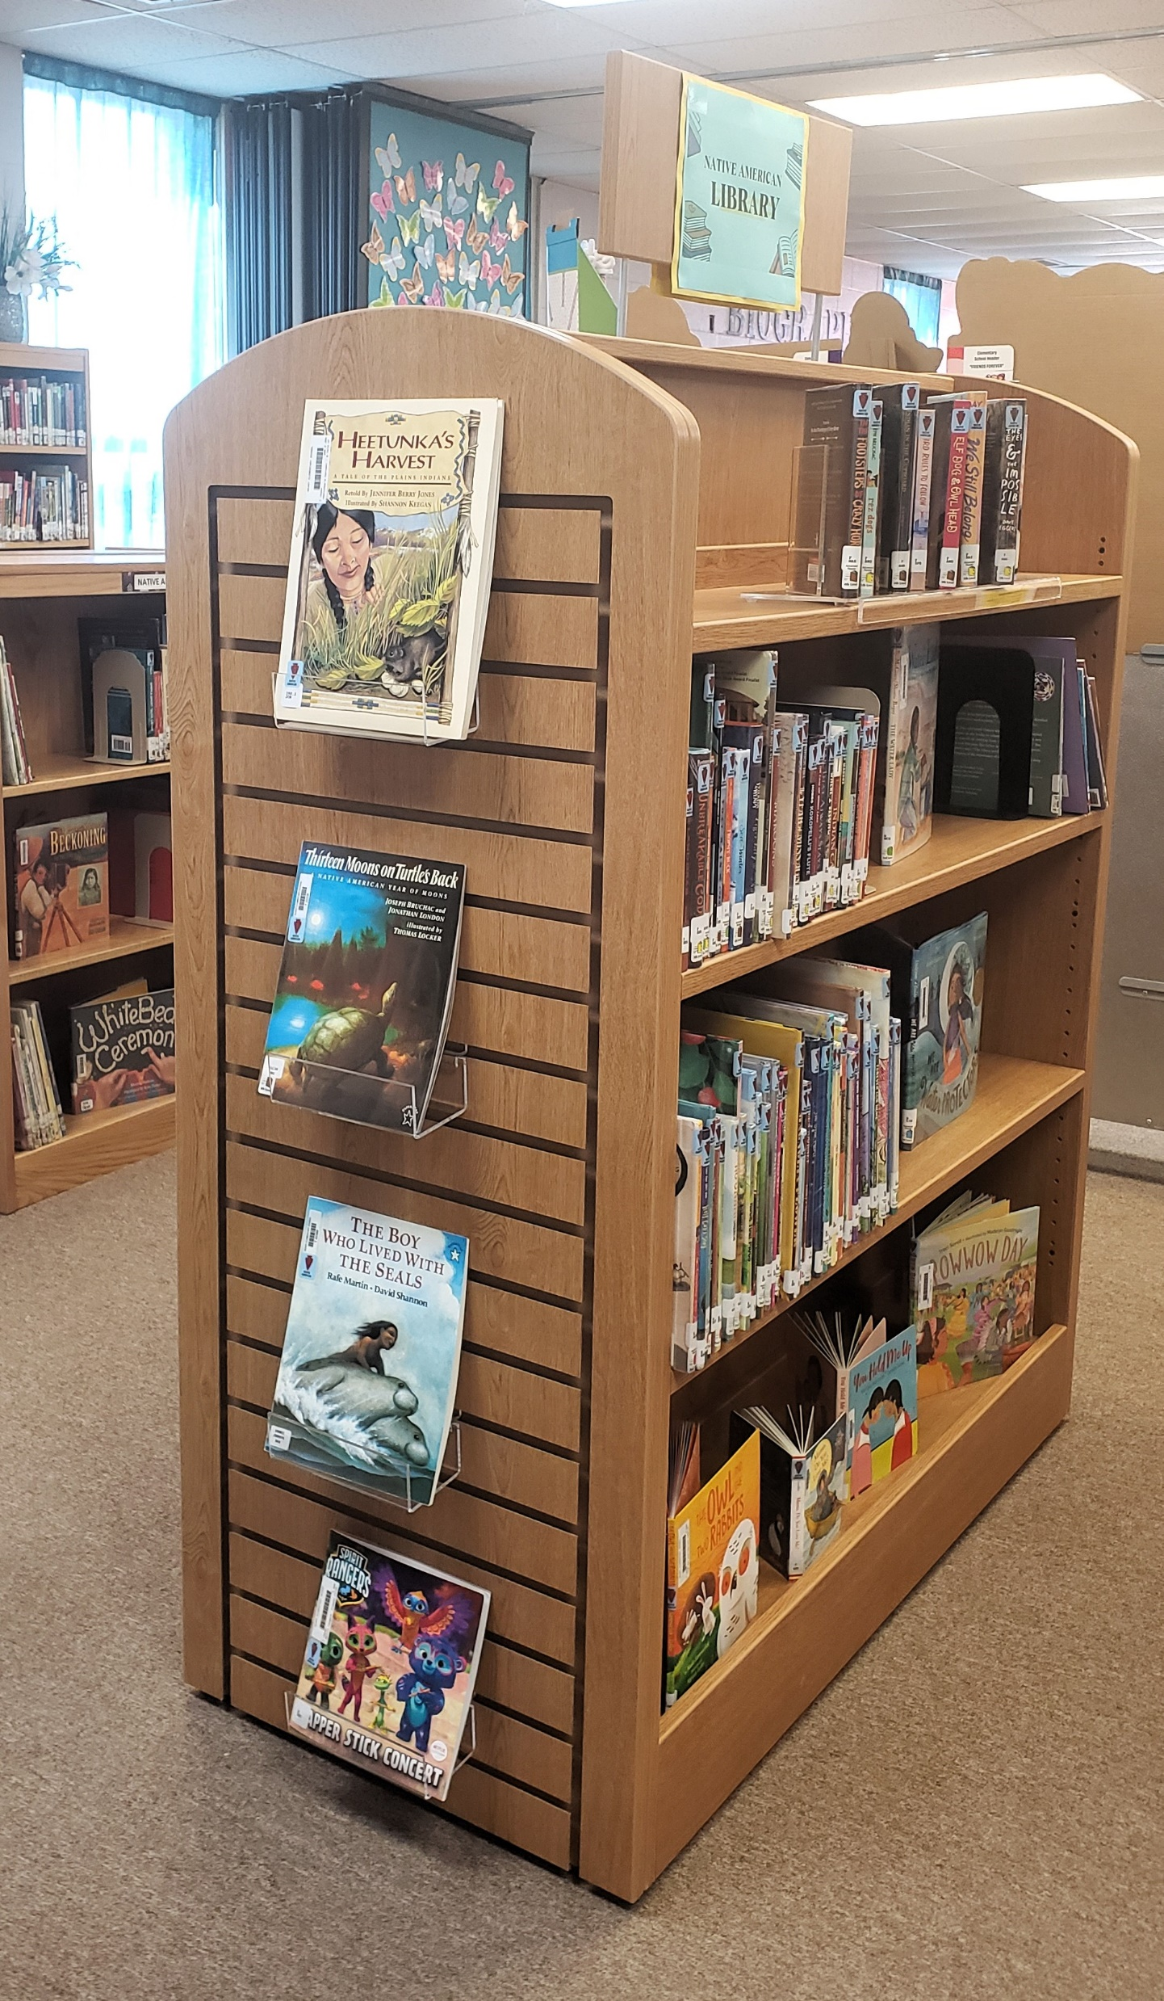

Slide 10
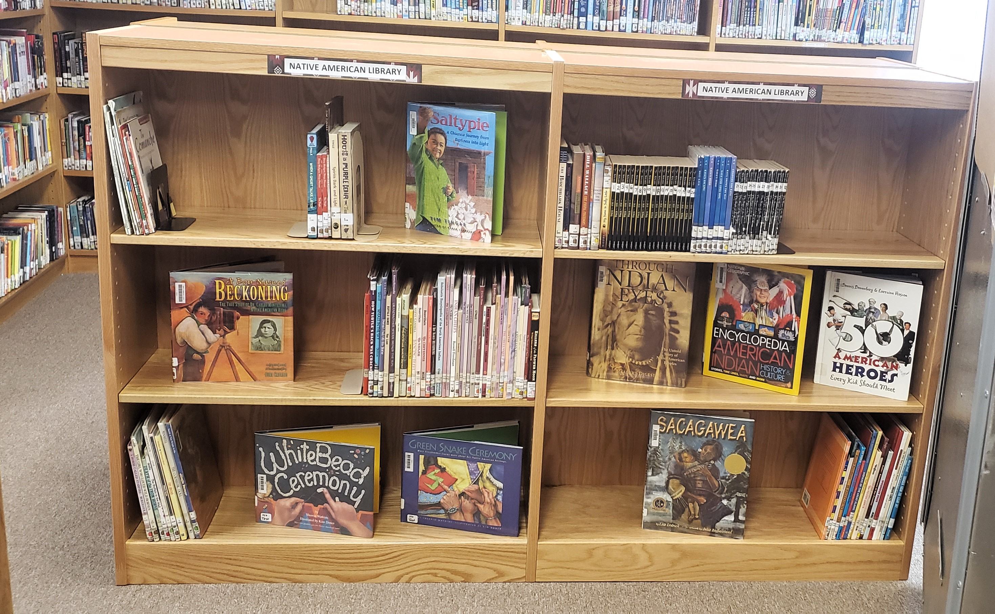

Slide 11
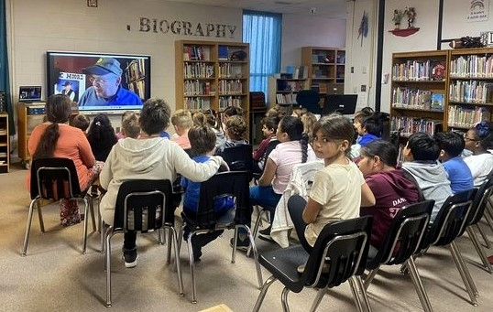
Tim Tingle, Choctaw Author & Storyteller,
March 27 at the Elementary School

Slide 12
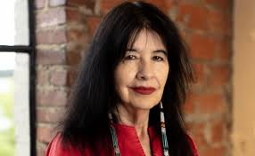
Coming April 16:
HS English Classes will have a virtual visit with Joy Harjo, Poet Laureate of the United States.

Slide 13
We Appreciate the Title VI Funding
For a Native American Library.
Thank You!

